Slide 1
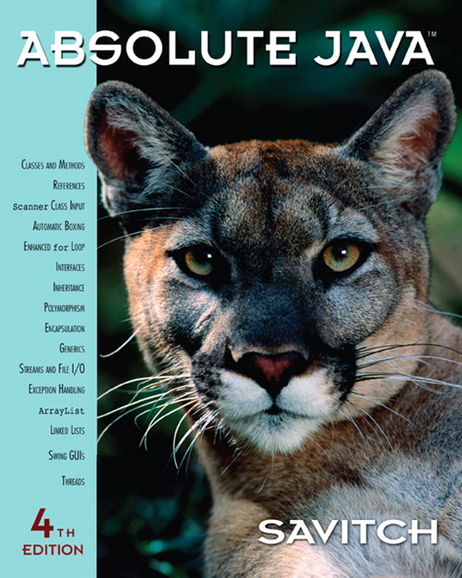

Chapter 12
UML and Patterns
Copyright © 2010 Pearson Addison-Wesley. All rights reserved.

Slide 2
Introduction to UML and Patterns
UML and patterns are two software design tools that can be used within the context of any OOP language
UML is a graphical language used for designing and documenting OOP software
A pattern in programming is a kind of template or outline of a software task
  A pattern can be realized as different code in different, but similar, applications
Copyright © 2010 Pearson Addison-Wesley. All rights reserved.
12-<number>

Slide 3
UML
Pseudocode is a way of representing a program in a linear and algebraic manner
  It simplifies design by eliminating the details of programming language syntax
Graphical representation systems for program design have also been used
  Flowcharts and structure diagrams for example
Unified Modeling Language (UML) is yet another graphical representation formalism
  UML is designed to reflect and be used with the OOP philosophy
Copyright © 2010 Pearson Addison-Wesley. All rights reserved.
12-<number>

Slide 4
History of UML
As OOP has developed, different groups have developed graphical or other representations for OOP design
In 1996, Brady Booch, Ivar Jacobson, and James Rumbaugh released an early version of UML
  Its purpose was to produce a standardized graphical representation language for object-oriented design and documentation
Since then, UML has been developed and revised in response to feedback from the OOP community
  Today, the UML standard is maintained and certified by the Object Management Group (OMG)
Copyright © 2010 Pearson Addison-Wesley. All rights reserved.
12-<number>

Slide 5
UML Class Diagrams
Classes are central to OOP, and the class diagram is the easiest of the UML graphical representations to understand and use
A class diagram is divided up into three sections
  The top section contains the class name
  The middle section contains the data specification for the class
  The bottom section contains the actions or methods of the class
Copyright © 2010 Pearson Addison-Wesley. All rights reserved.
12-<number>

Slide 6
UML Class Diagrams
The data specification for each piece of data in a UML diagram consists of its name, followed by a colon, followed by its type
Each name is preceded by a character that specifies its access type:
  A minus sign (-) indicates private access
  A plus sign (+) indicates public access
  A sharp (#) indicates protected access
  A tilde (~) indicates package access
Copyright © 2010 Pearson Addison-Wesley. All rights reserved.
12-<number>

Slide 7
UML Class Diagrams
Each method in a UML diagram is indicated by the name of the method, followed by its parenthesized parameter list, a colon, and its return type
The access type of each method is indicated in the same way as for data
Copyright © 2010 Pearson Addison-Wesley. All rights reserved.
12-<number>

Slide 8
UML Class Diagrams
A class diagram need not give a complete description of the class
  If a given analysis does not require that all the class members be represented, then those members are not listed in the class diagram
  Missing members are indicated with an ellipsis (three dots)
Copyright © 2010 Pearson Addison-Wesley. All rights reserved.
12-<number>

Slide 9
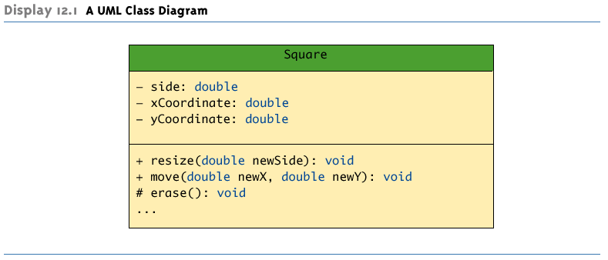
A UML Class Diagram
Copyright © 2010 Pearson Addison-Wesley. All rights reserved.
12-<number>

Slide 10
Class Interactions
Rather than show just the interface of a class, class diagrams are primarily designed to show the interactions among classes
UML has various ways to indicate the information flow from one class object to another using different sorts of annotated arrows
UML has annotations for class groupings into packages, for inheritance, and for other interactions
In addition to these established annotations, UML is extensible
Copyright © 2010 Pearson Addison-Wesley. All rights reserved.
12-<number>

Slide 11
Inheritance Diagrams
An inheritance diagram shows the relationship between a base class and its derived class(es)
  Normally, only as much of the class diagram is shown as is needed
  Note that each derived class may serve as the base class of its derived class(es)
Each base class is drawn above its derived class(es)
  An upward pointing arrow is drawn between them to indicate the inheritance relationship
Copyright © 2010 Pearson Addison-Wesley. All rights reserved.
12-<number>

Slide 12
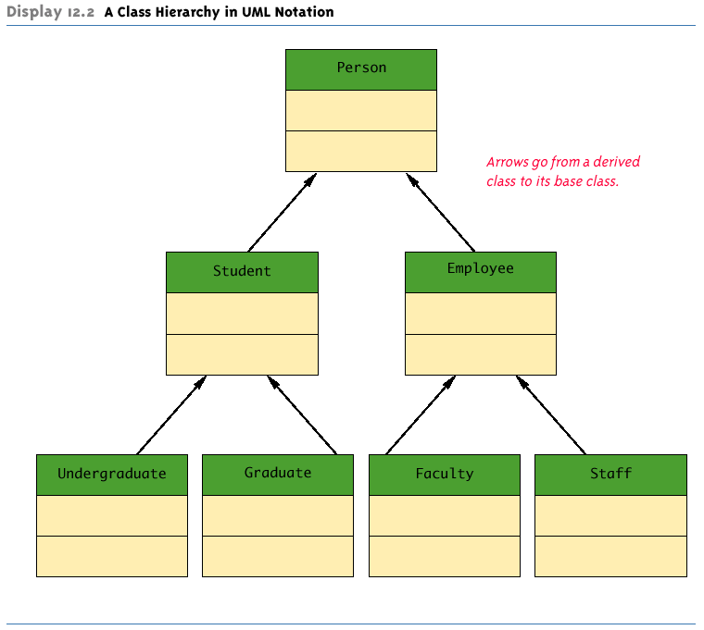
A Class Hierarchy in UML Notation
Copyright © 2010 Pearson Addison-Wesley. All rights reserved.
12-<number>

Slide 13
Inheritance Diagrams
The arrows also help in locating method definitions
To look for a method definition for a class:
  Examine the class definition first
  If the method is not found, the path of connecting arrows will show the order and direction in which to search
  Examine the parent class indicated by the connecting arrow
  If the method is still not found, then examine this parent's parent class indicated by the connecting arrow
  Continue until the method is found, or until the top base class is reached
Copyright © 2010 Pearson Addison-Wesley. All rights reserved.
12-<number>

Slide 14
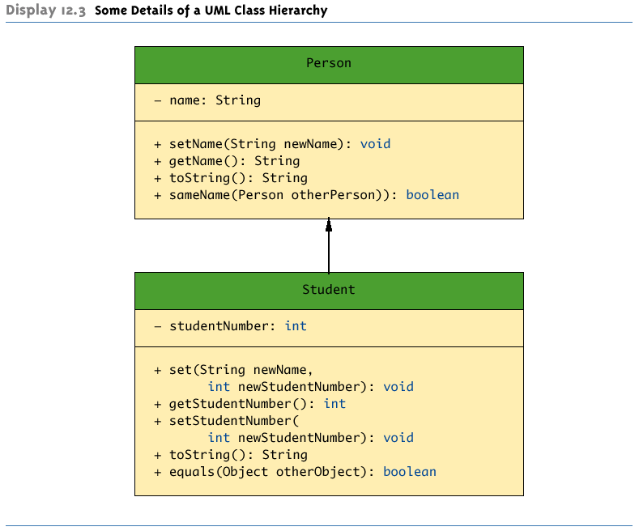
Some Details of a UML Class Hierarchy
Copyright © 2010 Pearson Addison-Wesley. All rights reserved.
12-<number>

Slide 15
Patterns
Patterns are design outlines that apply across a variety of software applications
  To be useful, a pattern must apply across a variety of situations
  To be substantive, a pattern must make some assumptions about the domain of applications to which it applies
Copyright © 2010 Pearson Addison-Wesley. All rights reserved.
12-<number>

Slide 16
Container-Iterator Pattern
A container is a class or other construct whose objects hold multiple pieces of data
  An array is a container
  Vectors and linked lists are containers
  A String value can be viewed as a container that contains the characters in the string
Any construct that can be used to cycle through all the items in a container is an iterator
  An array index is an iterator for an array
The Container-Iterator pattern describes how an iterator is used on a container
Copyright © 2010 Pearson Addison-Wesley. All rights reserved.
12-<number>

Slide 17
Adaptor Pattern
The Adaptor pattern transforms one class into a different class without changing the underlying class, but by merely adding a new interface
  For example, one way to create a stack data structure is to start with an array, then add the stack interface
Copyright © 2010 Pearson Addison-Wesley. All rights reserved.
12-<number>

Slide 18
The Model-View-Controller Pattern
The Model-View-Controller pattern is a way of separating the I/O task of an application from the rest of the application
  The Model part of the pattern performs the heart of the application
  The View part displays (outputs) a picture of the Model's state
  The Controller is the input part: It relays commands from the user to the Model
Copyright © 2010 Pearson Addison-Wesley. All rights reserved.
12-<number>

Slide 19
The Model-View-Controller Pattern
Each of the three interacting parts is normally realized as an object with responsibilities for its own tasks
The Model-View-Controller pattern is an example of a divide-and-conquer strategy
  One big task is divided into three smaller tasks with well-defined responsibilities
Copyright © 2010 Pearson Addison-Wesley. All rights reserved.
12-<number>

Slide 20
The Model-View-Controller Pattern
As an example, the Model might be a container class, such as an array.
The View might display one element of the array
The Controller would give commands to display the element at a specified index
The Model would notify the View to display a new element whenever the array contents changed or a different index location was given
Copyright © 2010 Pearson Addison-Wesley. All rights reserved.
12-<number>

Slide 21
The Model-View-Controller Pattern
Any application can be made to fit the Model-View-Controller pattern, but it is particularly well suited to GUI (Graphical User Interface) design projects
  The View can then be a visualization of the state of the Model
Copyright © 2010 Pearson Addison-Wesley. All rights reserved.
12-<number>

Slide 22
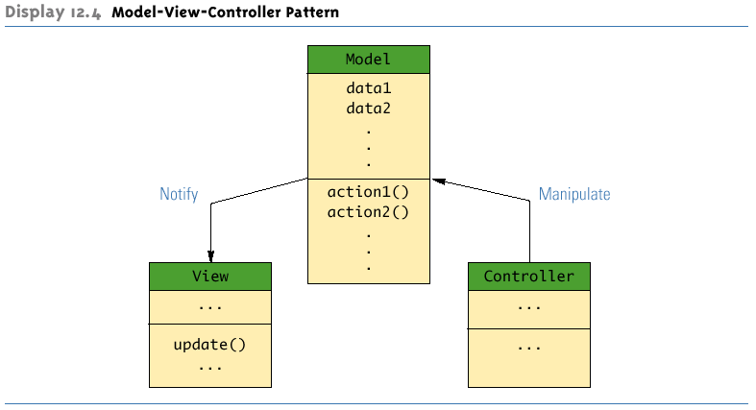
Model-View-Controller Pattern
Copyright © 2010 Pearson Addison-Wesley. All rights reserved.
12-<number>

Slide 23
A Sorting Pattern
The most efficient sorting algorithms all seem to follow a divide-and-conquer strategy
Given an array a, and using the < operator, these sorting algorithms:
  Divide the list of elements to be sorted into two smaller lists (split)
  Recursively sort the two smaller lists (sort)
  Then recombine the two sorted lists (join) to obtain the final sorted list
Copyright © 2010 Pearson Addison-Wesley. All rights reserved.
12-<number>

Slide 24
A Sorting Pattern
The method split rearranges the elements in the interval a[begin] through a[end] and divides the rearranged interval at splitPoint
The two smaller intervals are then sorted by a recursive call to the method sort
After the two smaller intervals are sorted, the method join combines them to obtain the final sorted version of the entire larger interval
Note that the pattern does not say exactly how the methods split and join are defined
  Different definitions of split and join will yield different sorting algorithms
Copyright © 2010 Pearson Addison-Wesley. All rights reserved.
12-<number>

Slide 25
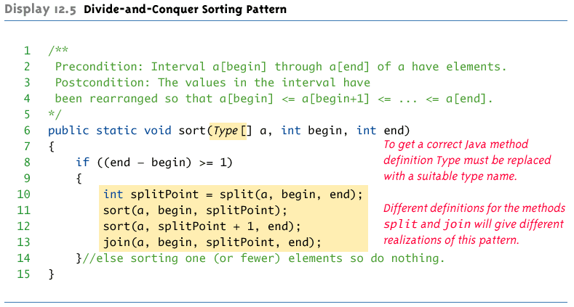
Divide-and-Conquer Sorting Pattern
Copyright © 2010 Pearson Addison-Wesley. All rights reserved.
12-<number>

Slide 26
Merge Sort
The simplest realization of this sorting pattern is the merge sort
The definition of split is very simple
  It divides the array into two intervals without rearranging the elements
The definition of join is more complicated
Note: There is a trade-off between the complexity of the methods split and join
  Either one can be made simpler at the expense of making the other more complicated
Copyright © 2010 Pearson Addison-Wesley. All rights reserved.
12-<number>

Slide 27
Merge Sort: the join method
  The merging starts by comparing the smallest elements in each smaller sorted interval
  The smaller of these two elements is the smallest of all the elements in either subinterval
  The method join makes use of a temporary array, and it is to this array that the smaller element is moved
  The process is repeated with the remaining elements in the two smaller sorted intervals to find the next smallest element, and so forth
Copyright © 2010 Pearson Addison-Wesley. All rights reserved.
12-<number>

Slide 28
Quick Sort
In the quick sort realization of the sorting pattern, the definition of split is quite sophisticated, while join is utterly simple
  First, an arbitrary value called the splitting value is chosen
  The elements in the array are rearranged:
    All elements less than or equal to the splitting value are placed at the front of the array
    All elements greater than the splitting value are placed at the back of the array
    The splitting value is placed in between the two
Copyright © 2010 Pearson Addison-Wesley. All rights reserved.
12-<number>

Slide 29
Quick Sort
Note that the smaller elements are not sorted, and the larger elements are not sorted
  However, all the elements before the splitting value are smaller than any of the elements after the splitting value
The smaller elements are then sorted by a recursive call, as are the larger elements
Then these two sorted segments are combined
  The join method actually does nothing
Copyright © 2010 Pearson Addison-Wesley. All rights reserved.
12-<number>

Slide 30
Restrictions on the Sorting Pattern
Like all patterns, the sorting pattern has some restrictions on where it applies
  It applies only to types for which the < operator is defined
  It applies only to sorting into increasing order
The pattern can be made more general, however
  The < operator can be replaced with a boolean valued method called compare
  The compare method would take two arguments of the base type of the array, and return true or false based on the comparison criteria
Copyright © 2010 Pearson Addison-Wesley. All rights reserved.
12-<number>

Slide 31
Efficiency of the Sorting Pattern
The most efficient implementations of the sorting pattern are those for which the split method divides the array into two substantial size chunks
  The merge sort split divides the array into two roughly equal parts, and is very efficient
  The quick sort split may or may not divide the array into two roughly equal parts
    When it does not, its worst-case running time is not as fast as that of merge sort
Copyright © 2010 Pearson Addison-Wesley. All rights reserved.
12-<number>

Slide 32
Efficiency of the Sorting Pattern
The selection sort algorithm (from Chapter 5) divides the array into two pieces: one with a single element, and one with the rest of the array interval
  Because of this uneven division, selection sort has a poor running time
  However, it is simple
Copyright © 2010 Pearson Addison-Wesley. All rights reserved.
12-<number>

Slide 33
Pragmatics and Patterns
Patterns are guides, not requirements
  It is not necessary to follow all the fine details
For example, quick sort was described by following the sorting pattern exactly
  Notice that, despite the fact that method calls incur overhead, the quick sort join method does nothing
  In practice calls to join would be eliminated
  Other optimizations can also be done once the general pattern of an algorithm is clear
Copyright © 2010 Pearson Addison-Wesley. All rights reserved.
12-<number>

